Slide 1

OPEN RESTAURANT INSPECTIONS New York City
By: Priyanshi Jaiswal, Drishti Kwatra, Sam Hulbert, Jason Haber, Xiaotong Hu
IS445 – Data Visualization
Prof. Mathew Turk
Notes:
Jason

Slide 2

Overview of the Project
We have made multiple visualizations to find some meaningful patterns in restaurant inspections conducted by the different agencies in New York City. We have currently looked at the compliancy rate of restaurants, number of restaurants, etc.
Notes:
Jason

Slide 3
Introduction
We have analyzed the dataset over different variables such as their compliance rate, the Seating choice, compliant restaurants based on districts, etc.
We have used Python to complete the data cleaning process and also to conduct an Exploratory Data Analysis
New York City is known for it’s restaurants and diverse cuisines. But these restaurants are constantly inspected by different agencies. In this project we have chosen a dataset which gets updated everytime a restaurant gets inspected by any of the agencies
Notes:
Jason

Slide 4
About the Dataset
Data | Attributes
This dataset has all the inspections done on restaurants by different agencies of New York | The attributes in the dataset are: Borough Restaurant_Name Seating_Choice Legal_Business_Name Business_Address Is_Roadway_Compliant Inspected_On Agency_Code Post_Code Latitude Longitude Community_Board Council_District
Notes:
Xiatong

Slide 5
Workflow
Visualization and Reporting
Raw Data Collection
Data Procession
Data Cleaning
Exploratory Data Analysis
Decision Making
Notes:
Xiatong

Slide 6
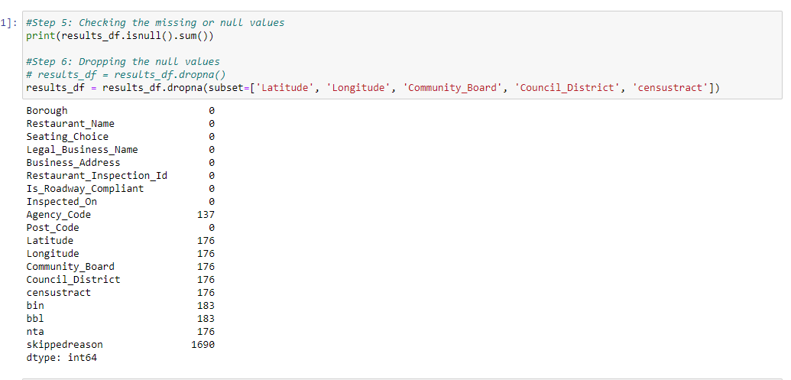
Data Processing & Cleaning
There were many columns which had null values. However, we removed null values from columns which didn’t result in a loss of data
Therefore, we only removed values from Latitude, Longitude, Community Board, Council District and Census Tract
Notes:
Xiatong

Slide 7
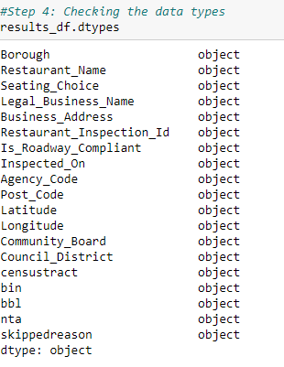
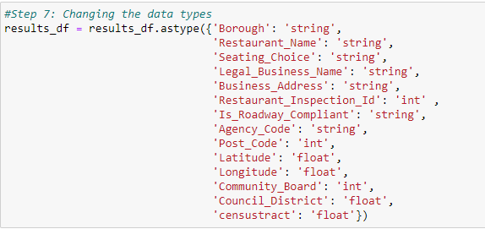
Data Processing & Cleaning
All the columns in the dataset were object data type. Hence, we made conversions on the dataset.
For Example: We converted Community Board, Latitude and Longitude variables into numerical categories(float, int) and Borough, Restaurant Names into String categories
Notes:
Xiatong

Slide 8
Insights after Exploratory Data Analysis
We have performed EDA on Jupyter Notebook using Pandas and NumPy. After that, we have used libraries such as matplotlib to visualize our insights from the data
Notes:
Drishti

Slide 9
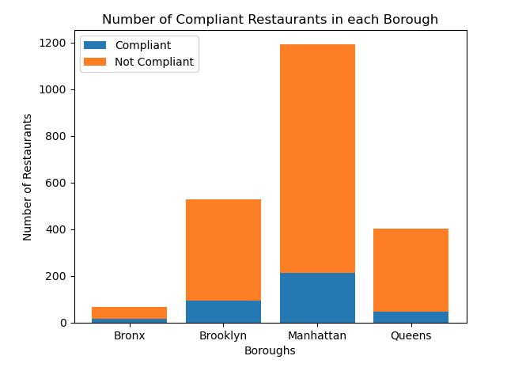
Visualization Insights​
We used the dataset to find out the ratio of compliant restaurants vs noncompliant restaurants.
Under the non-compliant restaurants there are some which are facing Cease and Desist orders, HIQA review, etc.
As we move further in the project, we would further drill down into each of these categories
Notes:
Drishti

Slide 10
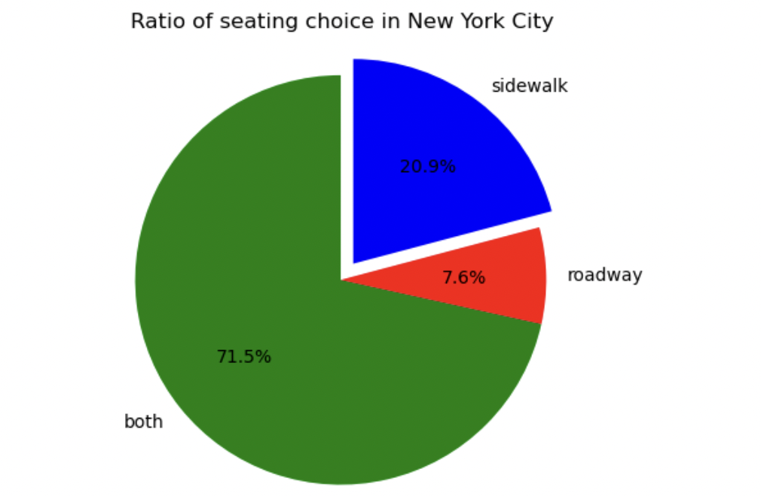
Visualization Insights​
All the restaurants in New York City are either on the roadway, sidewalk or both
From the visualization we concluded that the more than 70% of the restaurants have both sidewalk and roadway seating
The second most prominent category are sidewalk restaurants
Notes:
Drishti

Slide 11
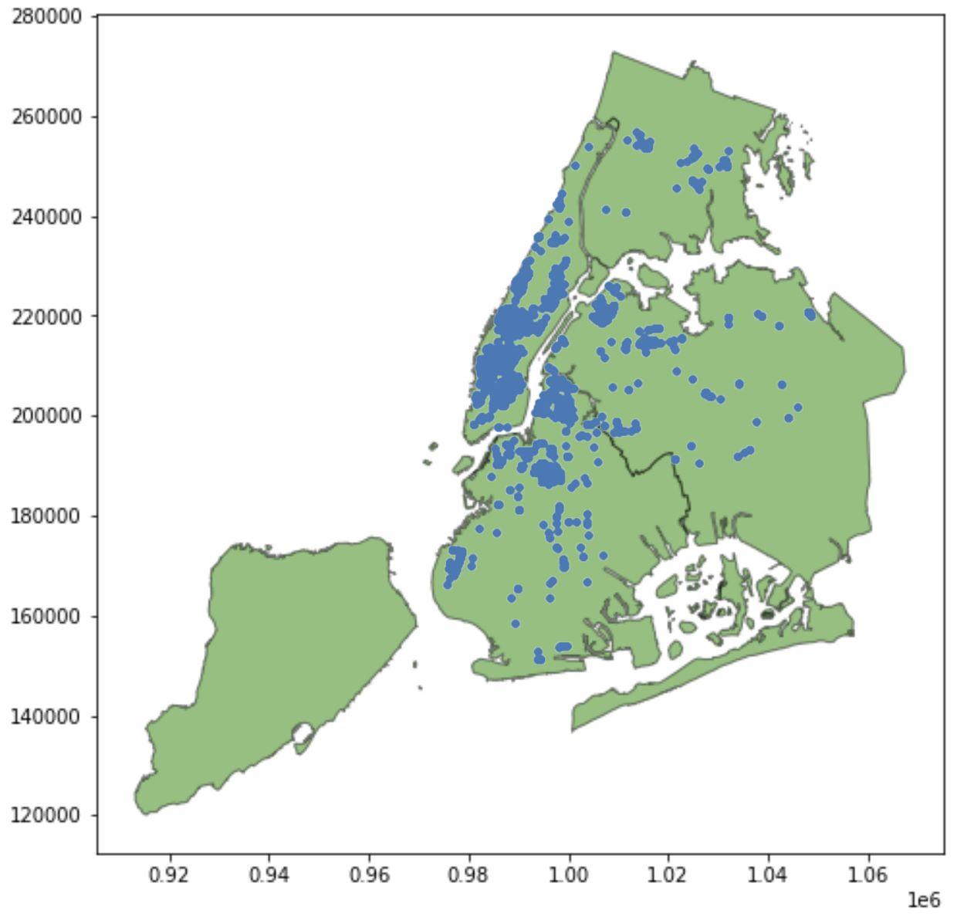
Visualization Insights​
This is a map of the restaurants in New York city that were inspected.
Most of these restaurants that were inspected were in the same general area (Manhattan)
This can also be seen in our bar graph of compliant and non-compliant restaurants
Notes:
Sam

Slide 12
Conclusion & Future Scope
Most of the restaurants are present in the Manhattan location of the New York
More than 60% of the restaurants are non-compliant
The project is in progress and we are still working on adding more visualizations
We have designed an employee award system for the University of Kentucky Employees.
Notes:
Priyanshi

Slide 13
Challenges
Dataset had a lot of null values and removing all of them was resulting in the loss of data
Converting data to correct data types (Pandas DataFrame to GeoPandas)
Data dictionary was not very easily understandable
Notes:
Priyanshi

Slide 14
Thank You! QnA & Suggestions?

